Slide 1
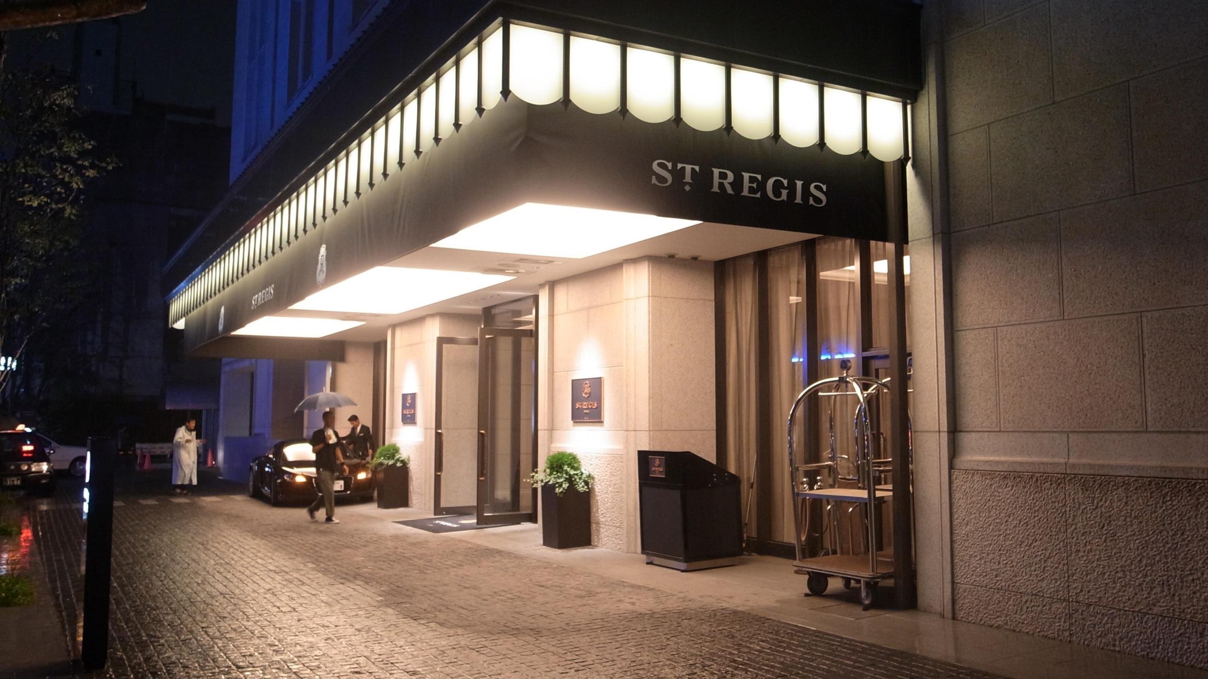






FutureTale
Hotel Reservation Case Study
This Photo by Unknown Author is licensed under CC BY-SA

Slide 2
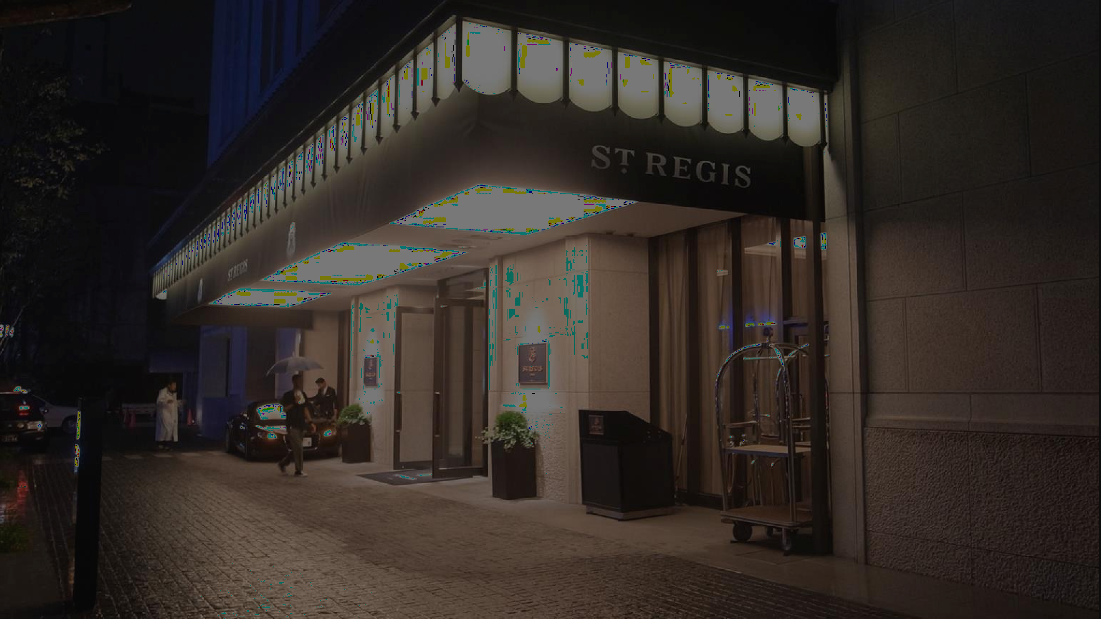
Case Study Overview
FutureTale Hotel speaks dynamic modernity. The Chinese Restaurant, Japanese Gourmet Restaurant, Lobby Lounge & Bars, and Grand Ballroom, as well as the guest rooms and suites, meet the most exacting comfort and service standards.
FutureTale hotel has noticed inconsistencies in their returns from 2017 t0 2018. Being a modern relaxation center with a booking platform, A significant number of hotel reservations are called-off due to cancellations or no-shows. The typical reasons for cancellations include change of plans, scheduling conflicts, etc. This is often made easier by the option to do so free of charge or preferably at a low cost which is beneficial to hotel guests, but it is a less desirable and possibly revenue- diminishing factor for hotels to deal with.
You have been employed as a Data Scientist to explore the data and provide some insights and recommendations
This Photo by Unknown Author is licensed under CC BY-SA

Slide 3
DATA DICTIONARY
Booking_ID: unique identifier of each booking
no_of_adults: Number of adults
no_of_children: Number of Children
no_of_weekend_nights: Number of weekend nights (Saturday or Sunday) the guest stayed or booked to stay at the hotel
no_of_week_nights: Number of weeknights (Monday to Friday) the guest stayed or booked to stay at the hotel
type_of_meal_plan: Type of meal plan booked by the customer:
required_car_parking_space: Does the customer require a car parking space? (0 - No, 1- Yes)
room_type_reserved: Type of room reserved by the customer. The values are ciphered (encoded) by INN Hotels.
lead_time: Number of days between the date of booking and the arrival date
arrival_year: Year of arrival date
arrival_month: Month of arrival date
arrival_date: Date of the month
market_segment_type: Market segment designation.
repeated_guest: Is the customer a repeated guest? (0 - No, 1- Yes)
no_of_previous_cancellations: Number of previous bookings that were canceled by the customer prior to the current booking
no_of_previous_bookings_not_canceled: Number of previous bookings not canceled by the customer prior to the current booking
avg_price_per_room: Average price per day of the reservation; prices of the rooms are dynamic. (in euros)
no_of_special_requests: Total number of special requests made by the customer (e.g. high floor, view from the room, etc)
booking_status: Flag indicating if the booking was canceled or not.

Slide 4
Recommendations
1. High Cancellation Segments:
Introductions of stricter cancellation policies or non-refundable rates for segments (e.g. “Meal_plan 1” and “Not_selected” in the Meal_plan segment and room_type 1 & 7 in Room_type_reserved segment have high cancellation rates.
2. Lead Time Management:
Implement dynamic pricing strategies where the price increases as the lead time increases to incentivize commitment.
3. Special Requests and Flexibility (High special requests between September – October)
Guests with more special requests might be less likely to cancel. It is recommended that offering personalized services and incentives for guests who make special requests may reduce cancellation rates.
4. Optimizing Booking Channels:
Some Booking channels have high cancellation behaviors. (e.g., online& offline channels)
Optimize these booking channels by offering promotions or stricter policies on channels with higher cancellation rates.
5. Seasonal Patterns:
Seasonal trends in cancellations (e.g., Had higher cancellations between June - October).
Recommendation: Implement targeted marketing campaigns during historically lower cancellations and adjust staffing and inventory accordingly.

